Slide 1
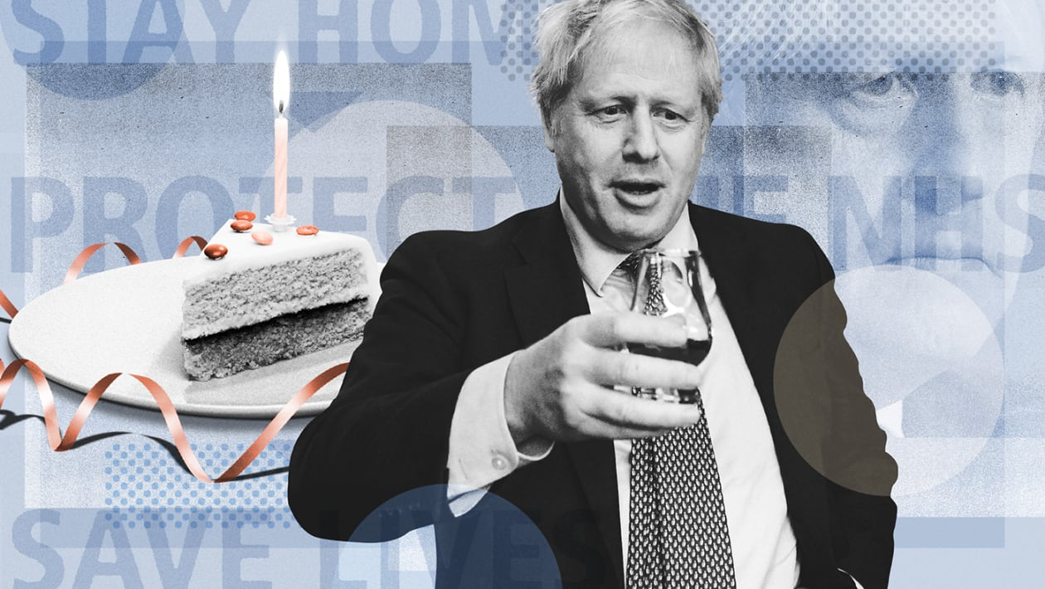



A question of morality? Preferences for liberties, lives and livelihoods during a pandemic
Mandy Ryan, Luis Enrique Loria-Rebolledo, Verity Watson (HERU, Aberdeen)
Mesfin Genie, Auburn Universitu
Ruben A. Sakowsky (Medical Ethics and History of Medicine, Gottingen)
Daniel Powell (Health Psychology, Aberdeen)
Shantini Paranjothy (Public Health Consultant, Aberdeen)
t

Slide 2
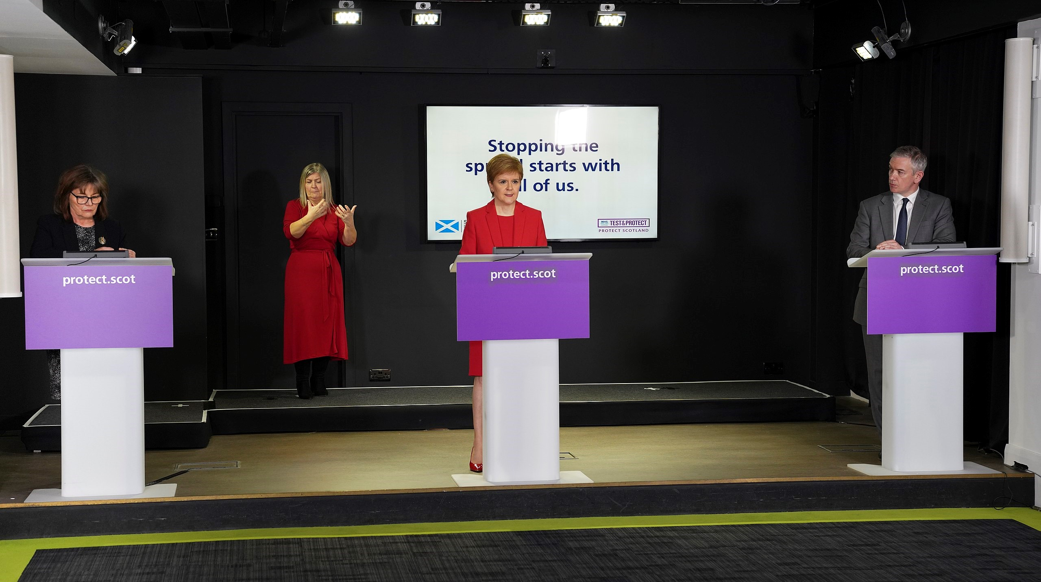

Slide 3
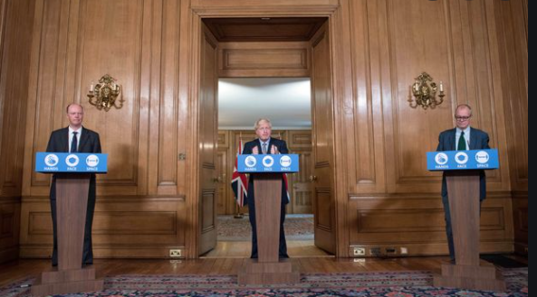

Slide 4
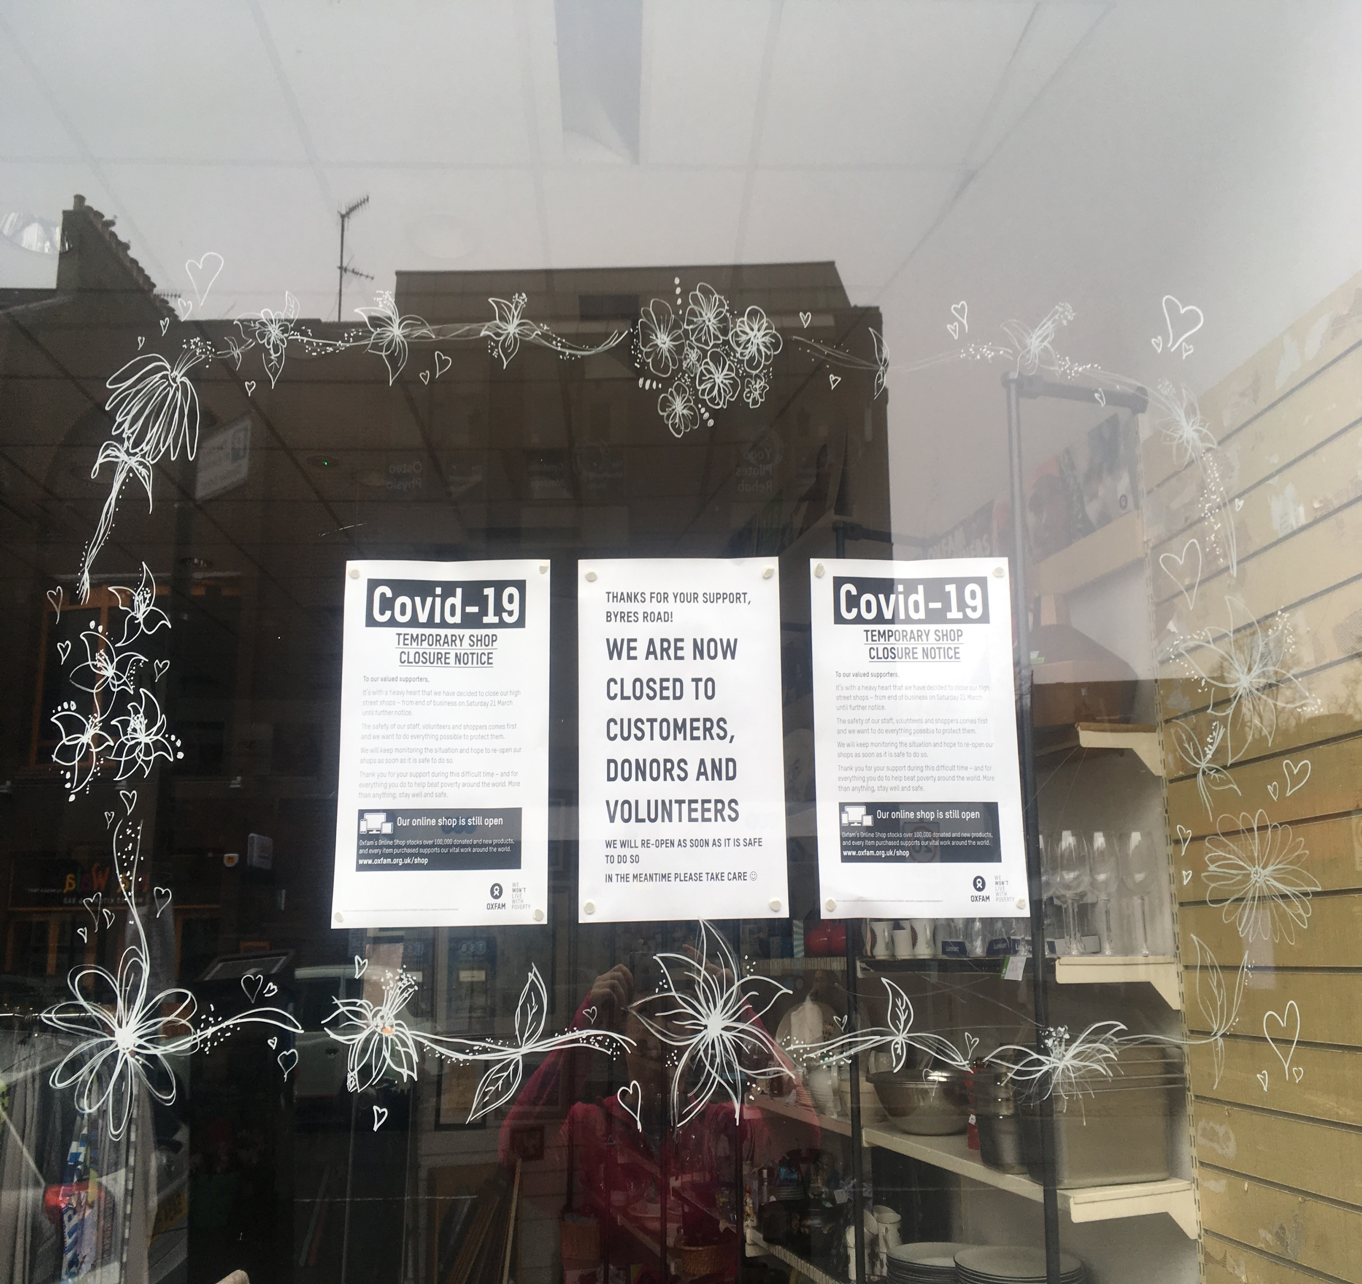
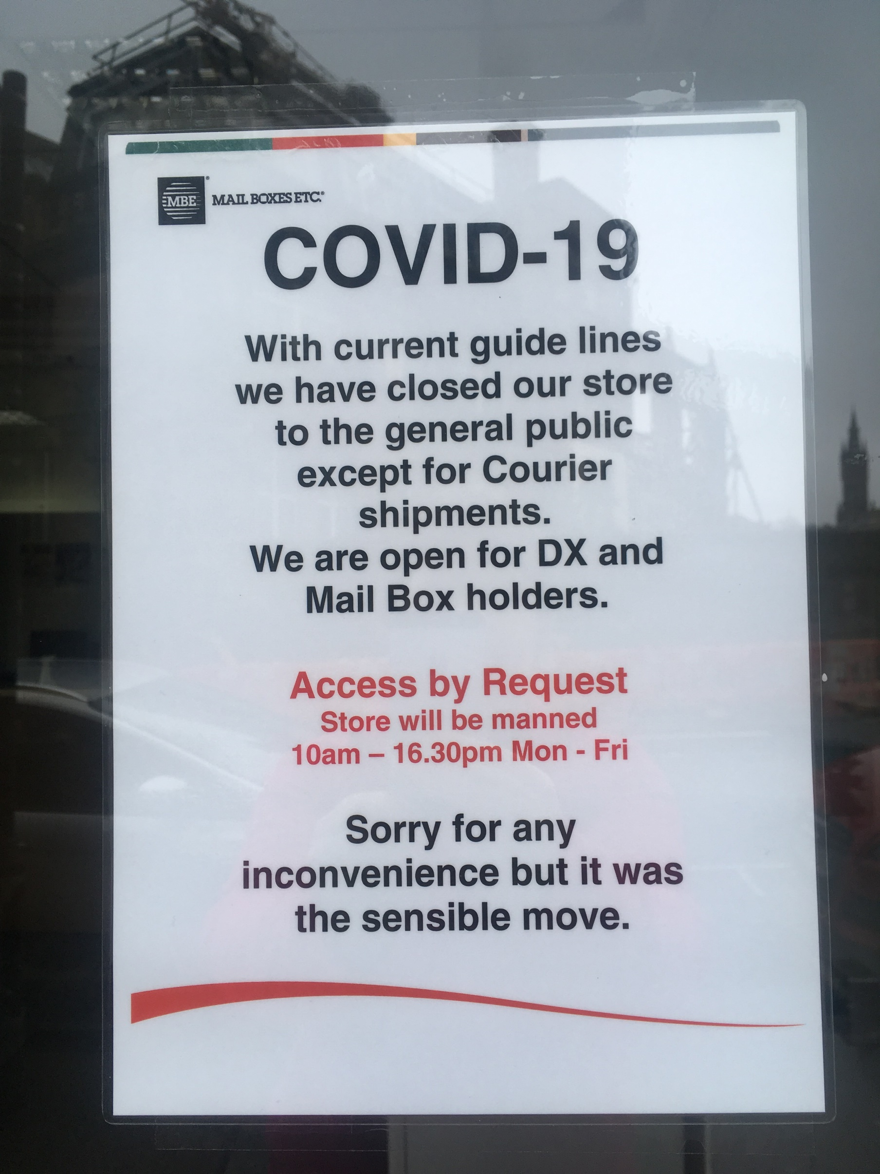

Slide 5
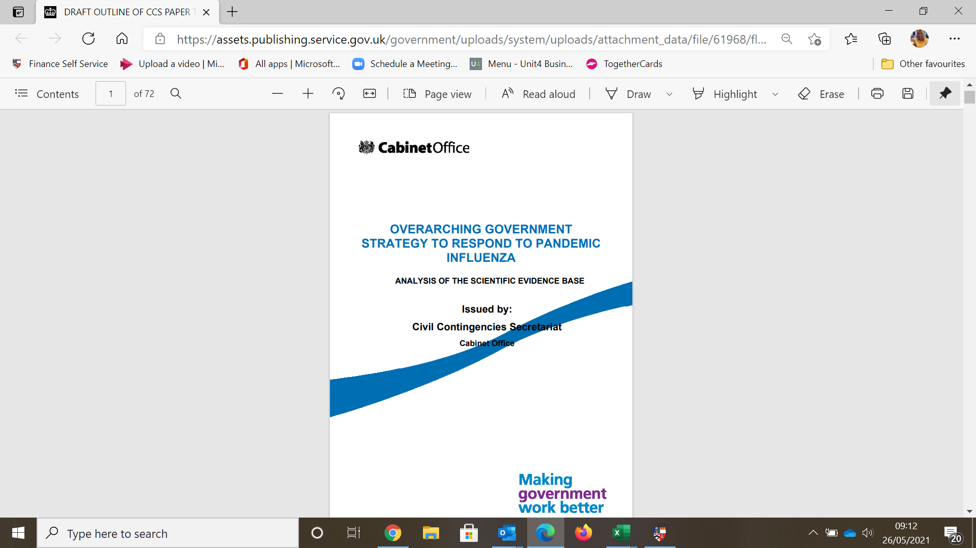
Overall the scientific evidence base for developing policy and/or guidance on social measures is limited. Even more limited is the evidence on the cost impacts of these measures, and the understanding of how people will think and behave in response to social measures. A better understanding of these social and psychological factors is a key gap in our understanding (Page 54).
January 2011

Slide 6
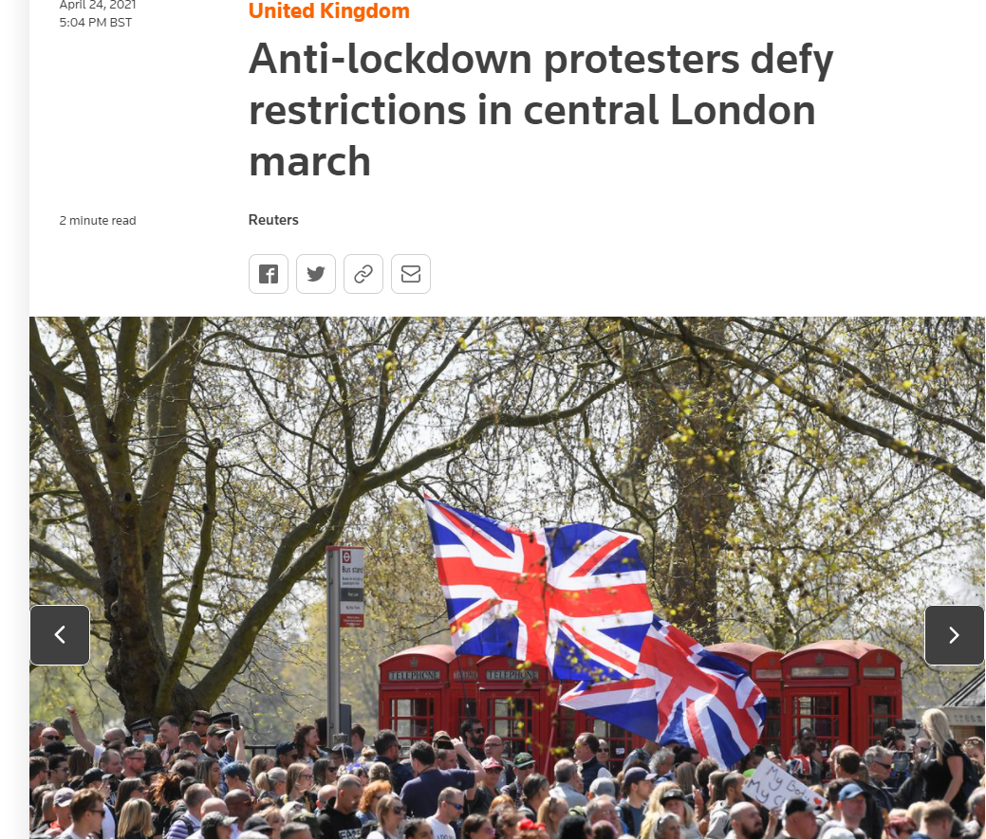
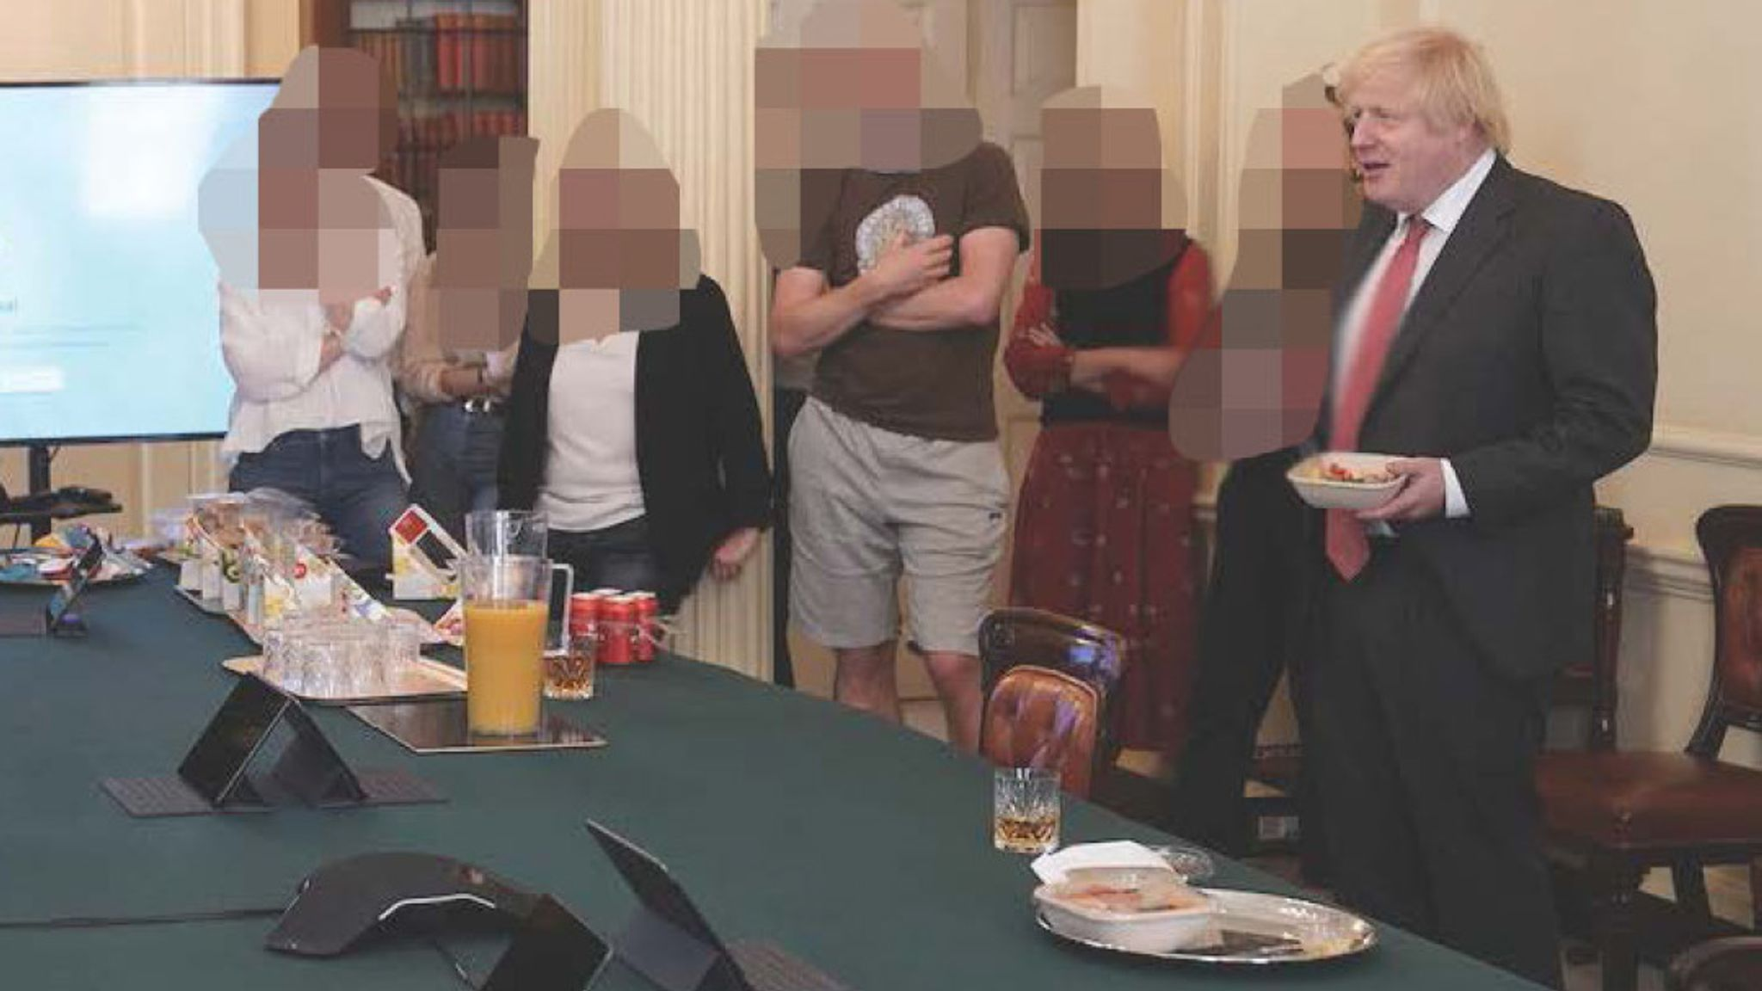

Slide 7
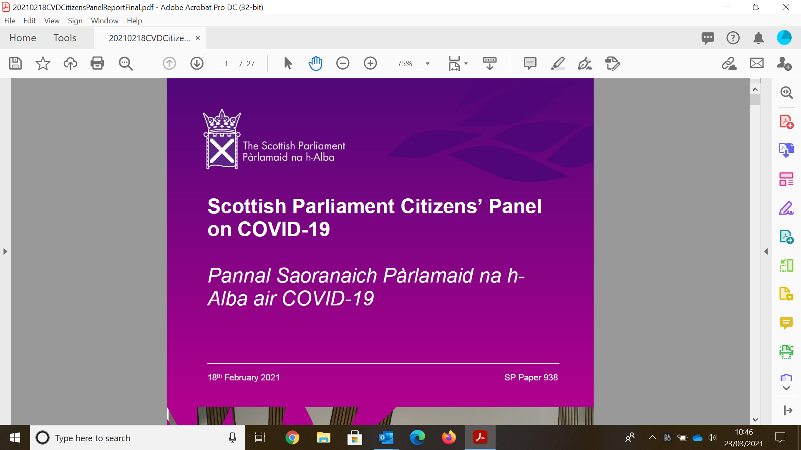
What priorities should shape the Scottish Government's approach to COVID-19 restrictions and strategy in 2021?
The panel believes the Scottish Government should focus on stopping the spread of virus, ideally by pursuing an ‘elimination’ strategy
(n=19)

Slide 8
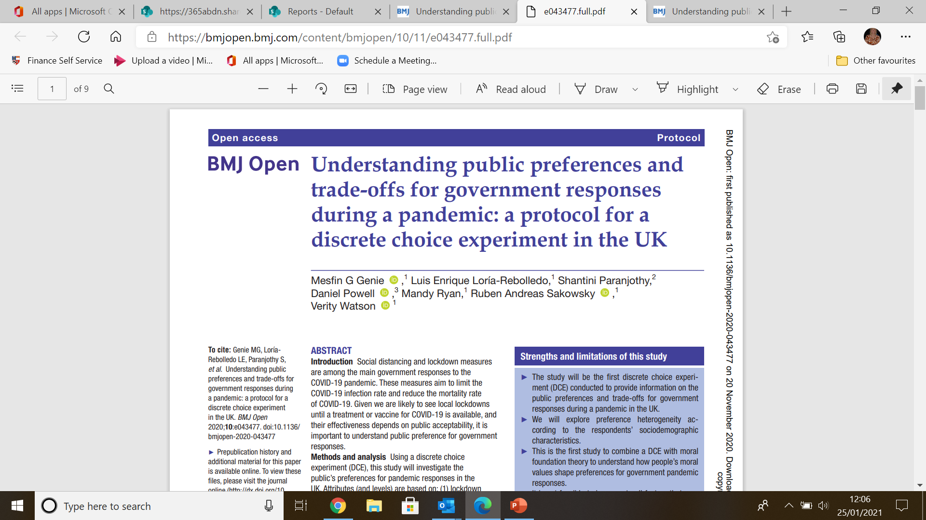




Slide 9


Slide 10
Attributes and levels
Attributes | Descriptions | Levels
Type of lockdown (Severity of restrictions) | How restrictive the lockdown (based on a colour/tier system) | Green, Yellow, Amber, Red
Lockdown length | How long the lockdown is in place | 3 weeks; 6 weeks ; 10 weeks; 16 weeks
Postponement of non-pandemic medical care | Whether non-pandemic medical care is postponed | No procedures are postponed Some procedures are postponed All procedures are postponed
Number of infections | Number of infections (expressed as a fraction of 10,000) | 100; 600; 1,300; 2,000
Excess deaths | Number of excess deaths (expressed as a fraction of 10,000) | 1; 4; 9; 13
Ability to buy things | How much of the goods that respondents are able to buy today will they be able to buy in a year’s time | 100% of shopping trolley; 90% of shopping trolley; 80% of shopping trolley; 70% of shopping trolley
Job losses | How many people lose their job (expressed as a fraction of 100) | 0; 4; 15; 25

Slide 11
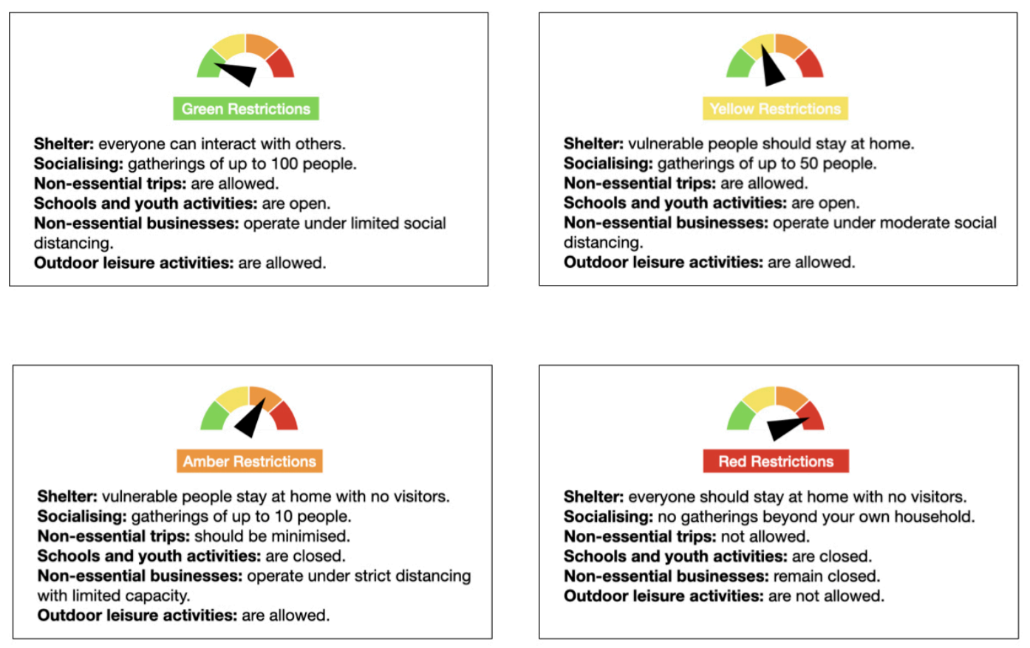
Restrictions

Slide 12
Attributes and levels
Attributes | Descriptions | Levels
Type of lockdown (Severity of restrictions) | How restrictive the lockdown (based on a colour/tier system) | Green, Yellow, Amber, Red
Lockdown length | How long the lockdown is in place | 3 weeks; 6 weeks ; 10 weeks; 16 weeks
Postponement of non-pandemic medical care | Whether non-pandemic medical care is postponed | No procedures are postponed Some procedures are postponed All procedures are postponed
Number of infections | Number of infections (expressed as a fraction of 10,000) | 100; 600; 1,300; 2,000
Excess deaths | Number of excess deaths (expressed as a fraction of 10,000) | 1; 4; 9; 13
Ability to buy things | How much of the goods that respondents are able to buy today will they be able to buy in a year’s time | 100% of shopping trolley; 90% of shopping trolley; 80% of shopping trolley; 70% of shopping trolley
Job losses | How many people lose their job (expressed as a fraction of 100) | 0; 4; 15; 25

Slide 13
Experimental Design – choosing the choice sets
D-efficient design
  24 choice tasks
  3 blocks
  8 tasks per respondent

Slide 14
Questionnaire development
Virtual think-aloud interviews
  Participants recruited via Facebook advertisement (n=23)
  Stakeholder Advisory Group (n=4) – four countries of the UK

Slide 15
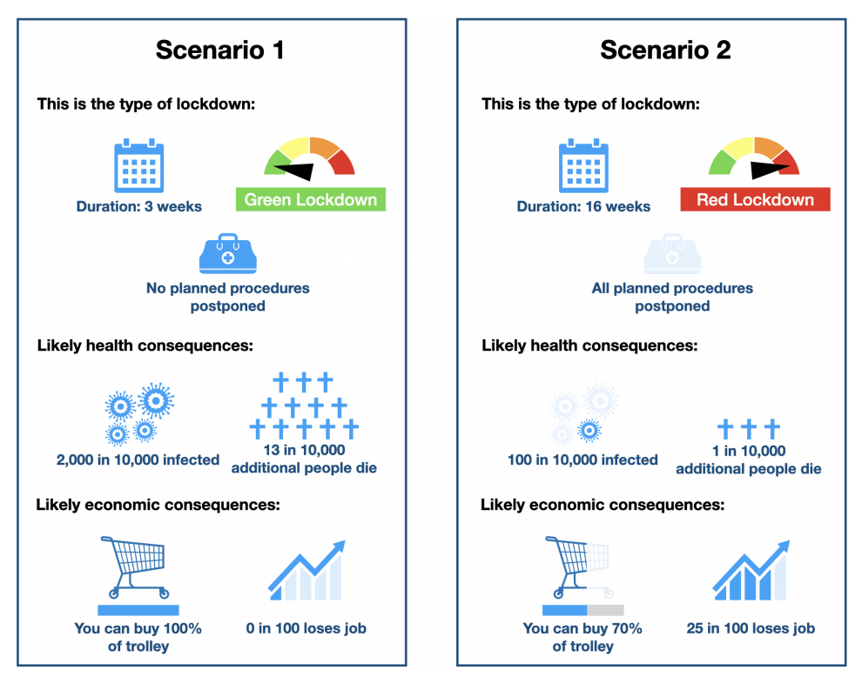
Example Choice Task

Slide 16
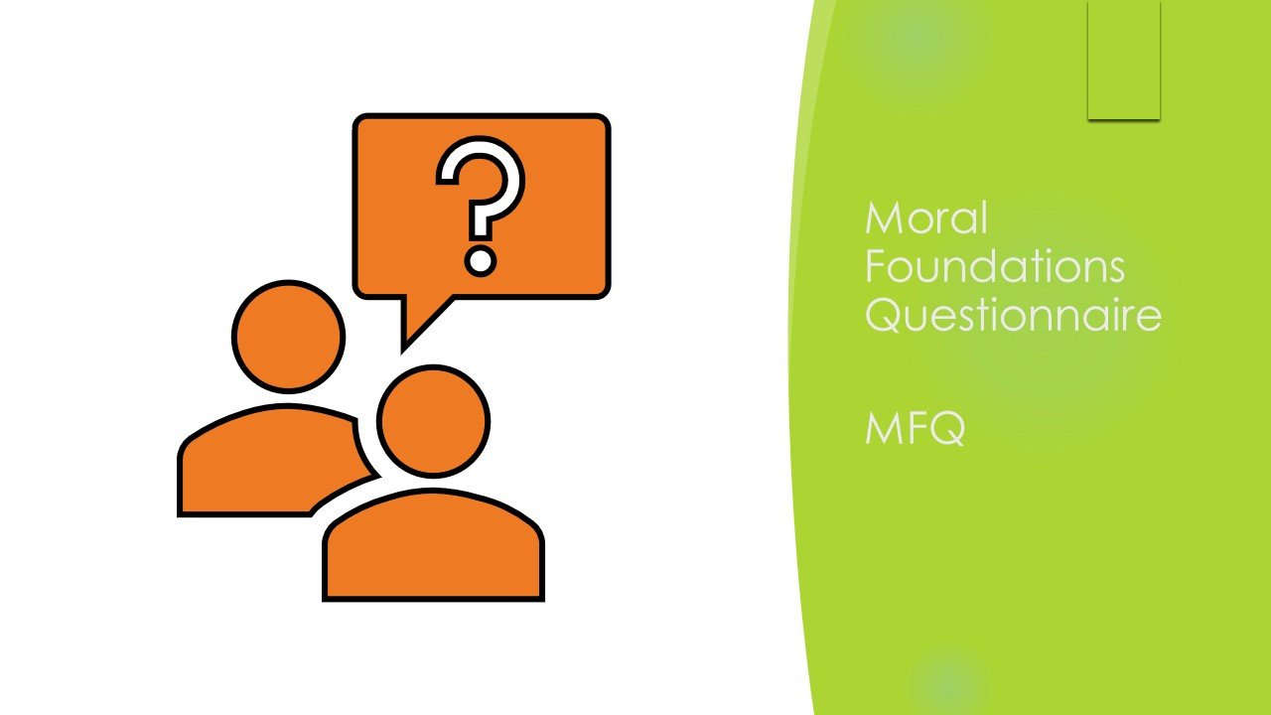
Pandemics represent a disease category that not only challenges our mortality but also forces us to consider our moral relations with others in society (Snowden, 2019).
Snowden, F. M. (2019). Epidemics and society: From the black death to the present. In Epidemics and Society: From the Black Death to the Present.

Slide 17
Preferences and trade-offs – a question of morality?
Moral Foundation Questionnaire – www.moralfoundations.org
5 basic moral foundations (intuitions)
    Caring – intuitions that prevent harm and caring for others
    Fairness – intuitions involving fair practices and equality
    Loyalty – protecting the interests of one’s own group
    Authority – respect for those higher in authority
    Sanctity – a motivation to be pure, both physically and spiritually
  Individualising foundations –caring for others and treating them fairly
  Binding foundations - loyalty, authority, and sanctity; focuses on preserving the ingroup

Slide 18
Survey Implementation
Online survey using online panel; quotas to ensure sample representativeness in age and sex.
Piloted early October using sample of 200 (50 per nation).
Main data collected late October to mid December (before and during England’s 2nd lockdown).
4201 respondents distributed as:
            England n=1112 Northern Ireland n=848
            Scotland n=1143 Wales n=1098

Slide 19
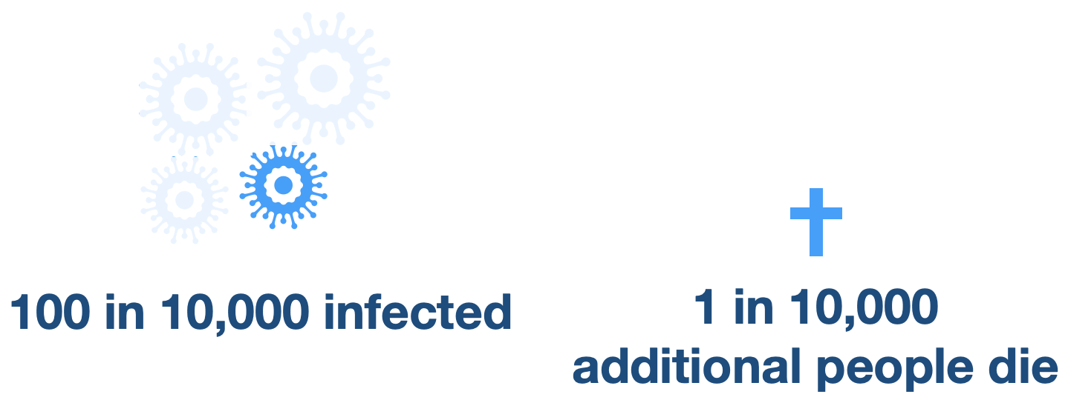
Did respondents always minimise excess deaths?... No
England: 20.2% Scotland: 22.9%
Northern Ireland: 22.8% Wales: 22.5%

Slide 20
Reduction in excess deaths required: a question of morality?
Hybrid Choice Model estimated in willingness to save lives space

Slide 21
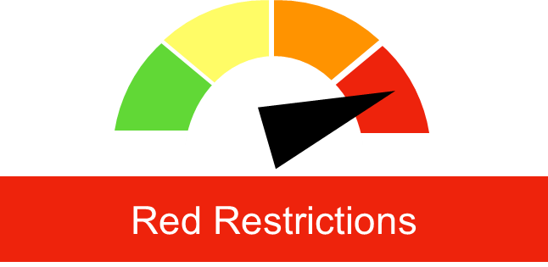
Reduction in excess deaths required to accept red lockdown for one week…
(-2.163 - 0.168) per 10,000 = 15,151
Duration: 1 week
(-2.163 + 0.399 – 0.168 + 0.051) per 10,000 =
12,227
If hold positive attitude to individualising foundation …
If hold positive attitude to binding foundation……
(- 2.163 + 1.338 – 0.168 - 0.039) per 10,000 = 6,708
UK Pop 2019: 65M

Slide 22

Reduction in excess deaths required to accept red lockdown for one week and 10% decrease in shopping trolley…
Duration: 1 week
(-2.163 - 0.168 - 0.634) per 10,000 =19,273
1% less in shopping trolley
If hold positive attitude to individualising foundation …
(-2.163 + 0.399 – 0.168 + 0.051 -0.634 + 0.105 ) per 10,000 = 15,665
If hold positive attitude to binding foundation …
(-2.163 + 1.338 – 0.168 - 0.039 -0.634 - 0.125 )
per 10,000 = 11,641
UK Pop 2019: 65M

Slide 23
Summary
Findings provide insight to trade-offs general public are willing to make
    80% respondents willing to make trade-offs
Can estimate value in terms of health and economics attributes and help design lockdown policy.
Moral Matters… What does this mean for public messaging?
Stability of preferences – have preferences changed now that people have experienced lockdowns?

Slide 24
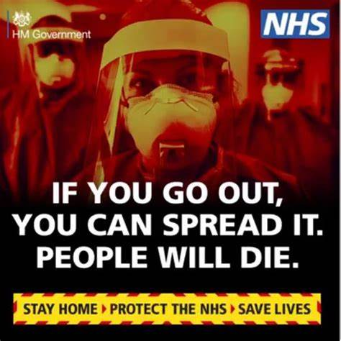
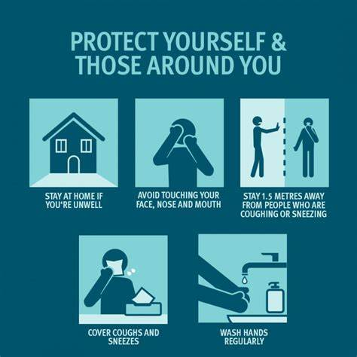
What does this mean for public messaging?
https://www.networkforphl.org/resources/guidance-for-framing-covid-19-messaging-using-the-moral-foundations-theory-framework/

Slide 25
Summary
Findings provide insight to trade-offs general public are willing to make
    80% respondents willing to make trade-offs
Can estimate value in terms of health and economics attributes and help design lockdown policy.
Moral Matters… What does this mean for public messaging?
Stability of preferences – have preferences changed now that people have experienced lockdowns?

