Slide 1
EQ-5D, HELPING THE WORLD MAKE BETTER HEALTH DECISIONS™
© EuroQol Research Foundation

Slide 2
EuroQol
The EuroQol Group (originally a multidisciplinary set of 14 people) began developing a measure of health status in 1987
Their aim was to create an instrument that could evaluate/assess, compare and value health across disease areas
After several years of development, the first EQ-5D* instrument (EQ-5D-3L) was established
A wide global network of experts (the EuroQol Group Association now has over 100 members) is committed to ongoing research on the evolving EQ-5D family of instruments
The EuroQol Office is based in the Netherlands and manages the distribution and licensing of the EQ-5D family of instruments as well as providing scientific support to users
The EuroQol Research Foundation is a non-profit organisation that invests all income into EQ-5D research, education and user support
* Please note that ‘EQ-5D’ is not an abbreviation and is the correct term to use in print or verbally

Slide 3
EuroQol vision and mission
Vision
The EuroQol Group Association and EuroQol Research Foundation aim to improve decisions about health and health care throughout the world by developing, promoting and supporting the use of instruments with the widest possible applicability for the measurement and valuation of health
Mission
To provide leadership in the research and development of instruments that describe and value health
To promote the use of instruments developed by the EuroQol Group and to support individuals and organisations across the world seeking to use those instruments
To foster and support an international community of researchers whose activity informs the development and application of EuroQol Group instruments
To ensure access to the accumulated research expertise of the EuroQol Group and to actively promote the transfer of knowledge and evidence regarding the use, analysis and interpretation of measures developed by the EuroQol Group
To support promising early career researchers in the field of health and quality-of-life research through involvement in EuroQol Group activities

Slide 4
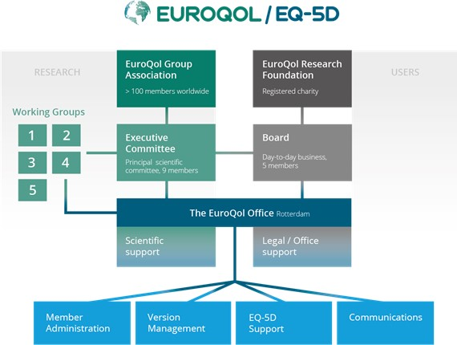
EuroQol

Slide 5
The EQ-5D
One of the world’s most popular measures of health outcomes
Developed over 30 years
As a short and simple questionnaire (5 questions and a visual analog scale), it is practical to use in studies
3 versions of the questionnaire in the EQ-5D portfolio
Developed by the EuroQol Group, an international network of researchers
Made available for use by the EuroQol Research Foundation
Measures health in terms of 5 dimensions (mobility, self-care, usual activities, pain and discomfort, anxiety and depression)

Slide 6
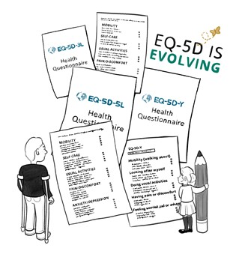
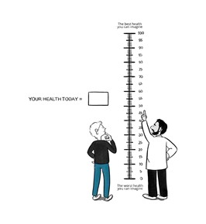
EQ-5D versions
There are 3 different versions of the EQ-5D:
EQ-5D-5L
Each dimension has 5 levels of severity
EQ-5D-3L
Each dimension has 3 levels of severity
EQ-5D-Y
Developed for use in children
Each dimension has 3 levels of severity
A visual analogue scale (VAS) is also included, as an overall measure of perceived health status

Slide 7
EQ-5D formats
EQ-5D is available in different formats and is therefore very flexible
The different modes of administration are:
Paper
Smartphone/Personal digital assistant (PDA)
Tablet
Laptop/desktop computer
There are self-complete, interviewer-administered (face-to-face and by telephone) and proxy versions
EQ-5D can also be used in interactive voice response systems
The Version Management Committee at EuroQol has responsibility for overseeing and approving all versions of the EQ-5D
It is important to use the latest EQ-5D version (https://euroqol.org/eq-5d-instruments/all-eq-5d-versions/).

Slide 8
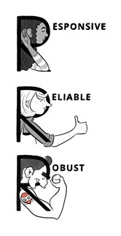
Scientific support for the EQ-5D
Extensive research shows that EQ-5D is a robust, reliable and responsive method of measuring health in a wide range of conditions and populations
Key publications for each version can be found on the EuroQol website
A wide range of research projects are ongoing to support the EQ-5D
The EuroQol membership and the staff at the EuroQol Office include scientific experts from many different fields

Slide 9
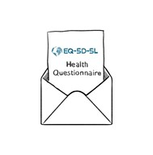
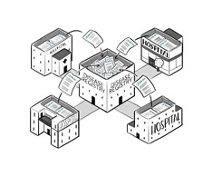
Studies using the EQ-5D
EQ-5D is extensively used
In 2015, it had been registered for use in more than 17,000 studies*
It has been used in studies undertaken in many different settings, such as:
Postal surveys of population health
Clinical trials to assess the impact of drugs or medical technologies
Disease registries for large real-world studies on specific conditions
In clinical practice, to collect routine outcome measurements
* Devlin and Brooks, 2017

Slide 10
International use of the EQ-5D
The EQ-5D has been used worldwide
In countries from Afghanistan to Zimbabwe
Translations are available in many different languages
The number continues to grow

Slide 11
EQ-5D translations
EQ-5D has been translated into more than 200 languages*
All translations/adaptations of EQ-5D are produced using a standardised translation protocol that conforms to internationally recognised guidelines
These guidelines aim to ensure equivalence to the English ‘source’ version and involve a forward/backward translation process and cognitive debriefing
Only the EuroQol Office can give permission for a translation to be performed and translations can only be stamped as official if they are performed in cooperation with EuroQol reviewers
More information is available in the User License Policy (https://euroqol.org/wp-content/uploads/2019/10/EQ-5D-User-License-Policy.pdf )
*A list of translations for all versions is available at: https://euroqol.org/eq-5d-instruments/all-eq-5d-versions/

Slide 12
EQ-5D value sets (1)
Scores from the EQ-5D can be translated into an overall number (a summary index value – or utility score) using a value set
A value set is developed by undertaking valuation research that measures people’s preferences with respect to health or, in other words, how health is valued
A representative sample of people from the general population of a given country participates in a standardised interview where they are asked to value health by reviewing EQ-5D health states
The output from this valuation study is a set of weights denoting the perceived severity of each level of each EQ-5D dimension
Using that set of weights, EQ-5D health states can be converted into a single summary index value for use in cost-utility analysis (CUA)

Slide 13
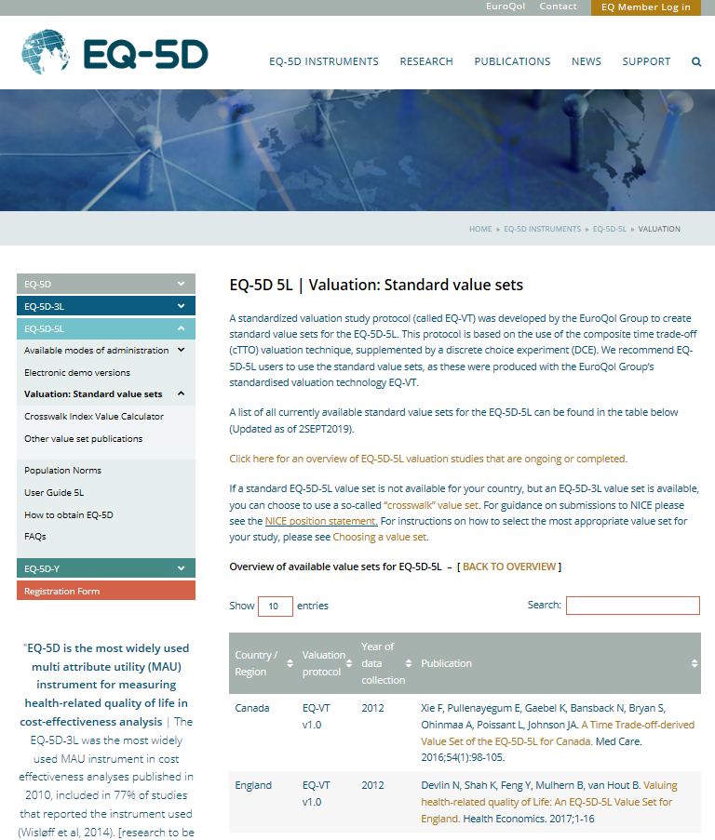
EQ-5D value sets (2)
There are currently 18 value* sets for the EQ-5D-5L and 33 value sets for the EQ-5D-3L
Additional valuation exercises are ongoing
EQ-5D-5L standard valuation studies are developed using a standard protocol, EQ-VT
EQ-VT uses state-of-the-art valuation techniques while also facilitating international comparability
Information on value sets is available on the EuroQol website
*developed using the EQ-VT

Slide 14
Use of EQ-5D across different conditions
As a generic measure, the EQ-5D is versatile enough to compare health across different disease areas
It has been used so far in over 100 different clinical areas

Slide 15
EQ-5D and health technology assessment
Health technology assessment (HTA) makes use of different methods of economic evaluation
Cost-utility analysis (CUA) is a form of cost-effectiveness analysis that reports the incremental cost per quality-adjusted life-year (QALY)
Estimation of QALYs is often based on health state utility values determined using a multi-attribute utility instrument (MAUI)
Several different MAUIs are available for indirect measurement of utilities in CUA
The EQ-5D is the most commonly cited MAUI* for use in HTA
It is the preferred MAUI, or given as an example of a suitable MAUI, in 85% of the pharmacoeconomic guidelines applied by HTA agencies for reimbursement or market access
The EQ-5D is cited in 29 guidelines, almost 3 times as often as the second most common MAUI which is mentioned in 11 guidelines
*Data on file, 2019

Slide 16
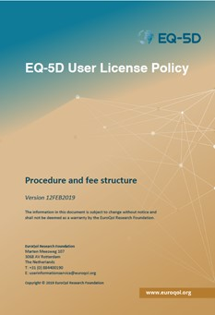
How to obtain EQ-5D for use in a study
Studies involving the EQ-5D need to be registered by completing the online EQ-5D registration form
The EuroQol Office then contacts the applicant by e-mail with information about the EQ-5D license policy, including licensing fees (if applicable)
The EQ-5D should not be amended unless permission is obtained from the Office
The steps to follow to obtain a copy of the EQ-5D are presented in a flowchart on the EuroQol Website

Slide 17
EQ-5D fee policy
Users must register to use the EQ-5D
The EuroQol Research Foundation does not charge a license fee for non-commercial use (research or non-research) of EQ-5D
Fees are payable for commercial use of EQ-5D
Licensing fees are dependent on the requested numbers of EQ-5D versions, languages, countries and modes of administration
There is no obligation to use the EQ-5D associated with completing the registration form
Further information on pricing is available in the User License Policy (https://euroqol.org/wp-content/uploads/2019/10/EQ-5D-User-License-Policy.pdf )

Slide 18
How EuroQol supports research
The EuroQol Research Foundation is committed to funding ongoing research on the EQ-5D and developing initiatives and materials to support users
Support is provided in many different forms, including:
Study grants
Research funding
Meetings
Translations
Publication support
Working groups
Education materials
White papers

Slide 19
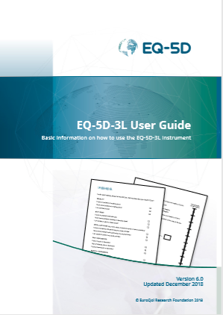
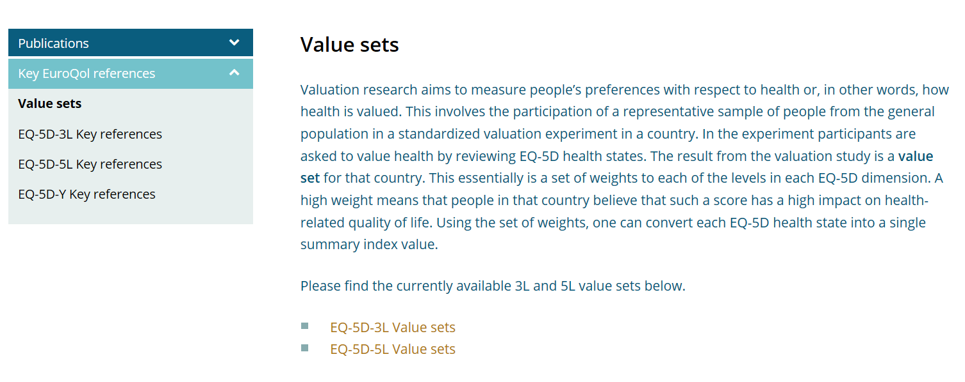
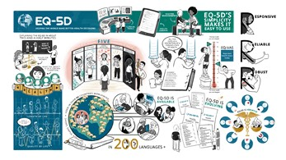
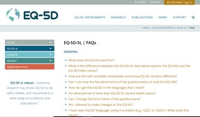
Resources to help use and analyse EQ-5D
EuroQol provides many different resources to help users understand:
What the EQ-5D is
How to apply to use it
How to analyse the data
Key resources include:
User guides
Value sets
Key references
Frequently asked questions (with answers!)
Teaching resources, such as:
Animation ‘Explaining the EQ-5D in ~2.5 minutes’
Infographic on the EQ-5D
New resources are being added all the time!

Slide 20
Any questions?
The EuroQol website at https://euroqol.org/ provides a wealth of further information
To speak to someone, call +31 88 440 0190
The office e-mail address is userinformationservice@euroqol.org

Slide 21
Copyright of this Powerpoint presentation
Including the copyright line '© EuroQol Research Foundation' is mandatory when using information and/or images and/or any part of this slide deck in any other work or publication.
Neither this presentation nor any of its parts may be sold, distributed or modified for commercial gain.

