Slide 1
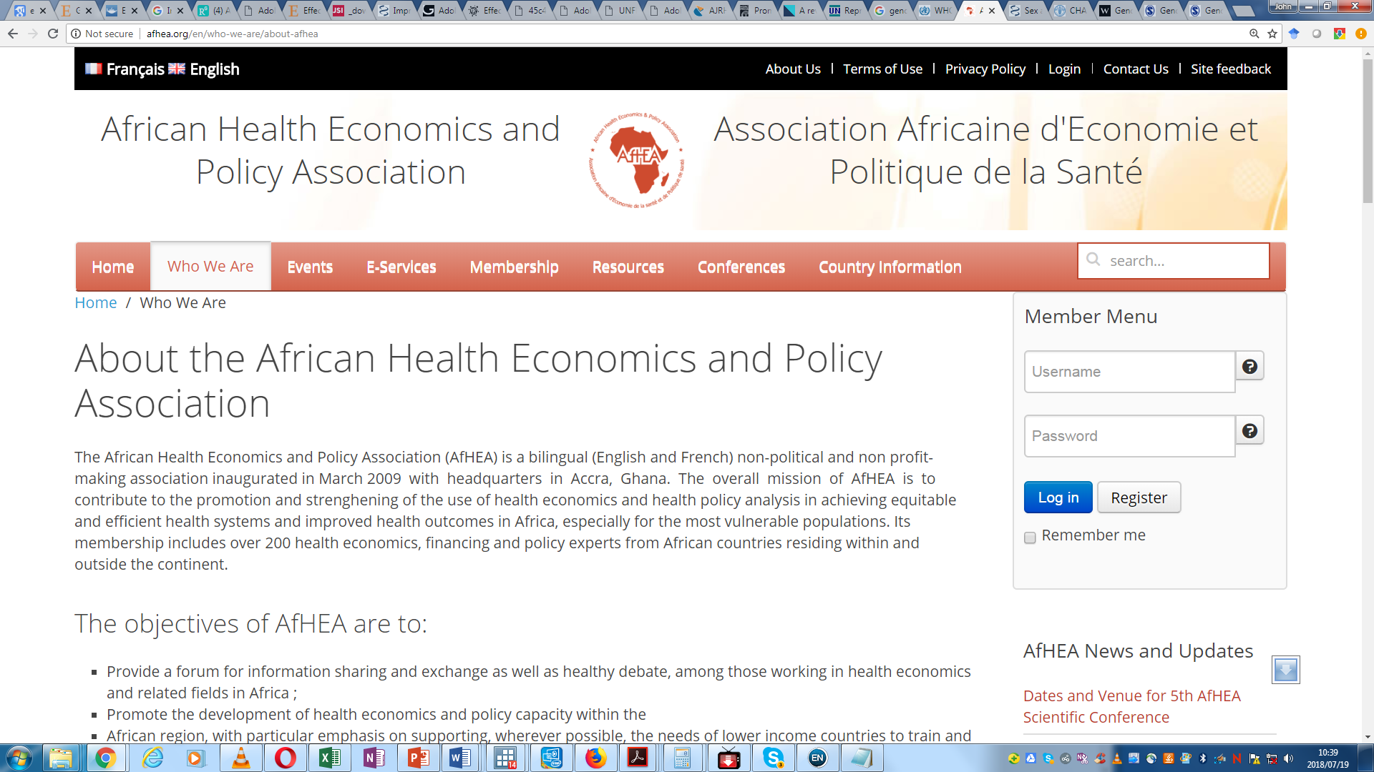
Economics of Adolescent Sexual and Reproductive Health Interventions in Ghana and Senegal (Ecasarh)
Webinar: International Health Economic Association (IHEA)- Economics of Children’s Health and Wellbeing SIG
7th September, 2023

Slide 2
Outline
Introduction
Project Overview
Results
    Priority areas selected
    Costing
    Qualitative study-sustainability funding for ASRH
Conclusion

Slide 3

Introduction
Pregnancy and delivery complications among adolescents and young girls
  Contribute significantly to mortality in the ECOWAS region
A strong desire to address the SRH challenges and needs of adolescents, especially girls.
  Costing existing interventions that have great potentials for improving ASRH and well-being is critical, among other things.

Slide 4
Domestic Government expenditure on reproductive health, ECOWAS (2018)
Benin | 3.25%
Burkina Faso | 10.03%
Cabo Verde | 21.29%
Côte d'Ivoire | 6.87%
Gambia | No data
Ghana | 3.36%
Guinea | 0.85%
Guinea-Bissau | No data
Liberia | 6.17%
Niger | 7.51%
Nigeria | 1.18%
Sao Tome and Principe | 11.77%
Senegal | 3.53%
Sierra Leone | No data
Togo | 1.06%
http://apps.who.int/nha/database/ViewData/Indicators/en

Slide 5
Project Overview
A significant challenge to the advancement of adolescent health is the availability and accessibility of health services to adolescents.
There is a dearth of studies documenting priority or effective interventions in the African context and little or no information exists on costing of these interventions.
There is also little or no information on the resource gap or the requirements for scaling up these interventions..
Given that government health budgets in Africa remain low, it is important to understand effective ways to mobilize equitable and sustainable domestic resources to finance ASRH interventions in Africa.
1
2
3
4

Slide 6
Objectives
The project aims to:
  Identify the components of “priority” interventions with concrete and detailed implementation requirements to achieve improved ASRH
  Cost interventions identified as ‘priority’ or effective for addressing adolescent health
  Assess resource needs, funding gaps and identify financing strategies to implement priority ASRH interventions using a multicomponent and multisectoral approach

Slide 7
Study Design and Methods
3. Stakeholder mapping: all actors concerned with ASRH activities (Ghana)
Process of Identification
A multilayer stakeholder engagement and consultative approach.
A three-tier architectural structure design is adopted for the work.
A core research team: responsible for drafting and production of documents and reports for the project.
A technical working group: responsible for assisting the core research team with relevant information and data as well as making key input to the draft reports and documents.
Population Council
CSOs/NGOs
Inception Workshop
PPAG
DKT
Face-to-Face meetings
Ministry of Health
Social Services
MoGCSW/Dept. of Social Welfare
Health Sector
Ghana Health Service
Virtual Meetings
CHAG
UNFPA
Technical working groups
Development Partners
UNICEF
UK Aid

Slide 8
Priority interventions to achieve improved ASRH in Ghana and Senegal

Slide 9
Criteria for Identifying Priority interventions or strategies to address ASRH challenges in Ghana
i. Targeting social determinants
ii. Targeting proximal social
determinants (community support)
iii. Targeting knowledge, behaviour
and lifestyle
Education in general, especially secondary education
Promoting and strengthening legal or policy measures with the participation of adolescents and youth.
Promoting the economic “empowerment” of girls.
Wide dissemination of information through communities, schools, traditional and new media
Promoting parental/guardian commitment and communication between parents and children
At community level:
  Mobilisation of adults and community leaders
  Sensitisation of boys and men for the promotion of norms of equity and gender
Creation of safe environments for girls (establishing trust, promoting communication and dialogue)
Adolescent and youth-friendly centres adequately established
Peer education implemented within programmes
Promoting parental/guardian commitment and communication
iv. Targeting adolescents and youth health problems
Combination:
  Training of service providers
  Improving appropriate service facilities
  Wide dissemination of information through communities, schools and traditional and new media
Establishment of adolescent and youth-friendly health centres
Development of standards of quality services for adolescents and youth
Access to contraception
Focused antenatal care for pregnant adolescents
Source: Adapted from West African Health Organization (2016)

Slide 10
CROSS-CUTTING CRITERIA
1
Target the overall country response
Clear alignment of interventions on the needs and priorities of adolescents
2
Coordinate with other stakeholders and embrace a multidisciplinary approach
3
Sustainability of the priority interventions must be clearly stated including funding mechanism to ensure continuity of program or intervention
4
Measures to provide disaggregated data on adolescents and young people to ensure proper monitoring of progress and impact evaluation

Slide 11
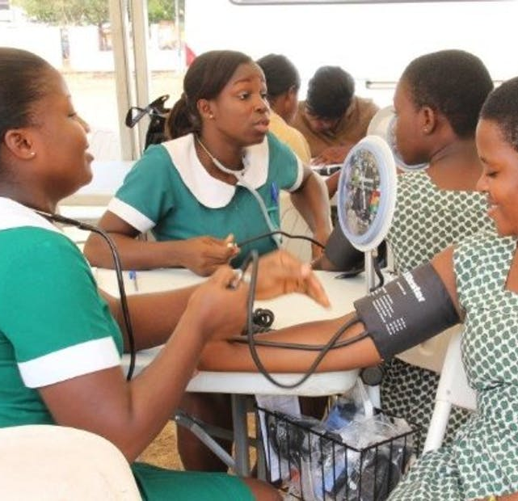
Ghana
7 interventions identified
4 prioritised for costing

Slide 12
No. | Intervention | Targeting social determinants | Targeting proximal social determinants (community support) | Targeting knowledge, behaviour and lifestyle | Targeting adolescents and youth health problems | Key Implementers and Funding Agencies
1 | Adolescent Clubs | Peer education and mentorship | Program engages schools and the communities | Health promotion Youth empowerment through participation Positive peer pressure | Improved access and use of adolescent and youth-friendly health services Young people are trained and mentored by health service providers to be Health Ambassadors who promote health and development in their schools and communities using all available channels to engage their peers and other stakeholders. Roll out is across the country. | UNICEF, UNFPA Marie-Stopes International (MSI)
2 | Safety Net program | Ensure universal education for girls so that pregnant adolescents return to school, and ensure that policies and legislation enable adolescent girls to give consent for tests and treatment. | Provide social support for pregnant adolescents, especially those who are very young. | Provide information about rights and choices for adolescents, including sexuality education for all adolescents. | The GHS designed the “Safety net” programme to provide a comprehensive plan of care for adolescent pregnant girls and is being piloted in the Tolon, Kpandai, North Dayi, Krachi East and Ketu South districts. Make pregnancy, childbirth and post delivery services more accessible to adolescents and more responsive to their needs (adolescent friendly). Restricted to 8 districts in 2 regions | UNICEF, UNFPA and others
3 | Ghana Adolescent Reproductive Health (ARH) Programme | To increase the number of girls who transition to senior secondary school | Program uses adolescent–parent dialogue meetings as an effective fora for mobilising communal action | To reduce the teenage pregnancy rate | To strengthen reproductive health in Ghana, with a focus on adolescents Increase uptake of postpartum family planning services among adolescent mothers Service delivery and operational research: this component delivers ASRH services in 27 districts of Brong Ahafo Region | DFID with the implementing partners being NPC, GES and FHD of GHS

Slide 13
No. | Intervention | Targeting social determinants | Targeting proximal social determinants (community support) | Targeting knowledge, behaviour and lifestyle | Targeting adolescents and youth health problems | Key Implementers and Funding Agencies
4 | Nutrition Program – Girls’ Iron-Folate Tablet Supplementation programme (GIFTS) | To provide adolescent girls with weekly iron and folic acid tablets free of charge to help prevent anaemia | Program engages actively with parents, family and community members, teachers and health workers | Improve knowledge of adolescent girls and women on the causes and prevention of anaemia | All adolescent girls in Junior High School (JHS) and Senior High (SHS) School, Technical Vocational Education and Training (TVET) Institutions Out-of-school adolescent girls 10 to 19 years Micronutrient supplementation for children, adolescent girls and women of child-bearing age* | Ghana Health Service and Ghana Education Service with funding and technical support from UNICEF and KOICA
5 | Strengthened national capacity in delivering high-quality integrated family planning and comprehensive maternal health services |  | Program engages with adolescents and youth-centered NGOs, CSOs, the private sector, Faith-Based Organizations (FBOs) | Improving access to family planning and contraceptives | For adolescents and youth, including in humanitarian settings Programming in the following areas: Maternal Health (Emergency maternal and Newborn Care (EmONC), Midwifery, Family Planning and Obstetric Fistula contribute to achieving this output. | UNFPA, PPAG, Marie-Stopes International (MSI)
6 | Empowering Adolescent Girls Through Comprehensive Sexuality Education | Focusing on adolescent girls' health, education and well-being | UNFPA employed a multi-sectoral approach with the government, CSOs, traditional authorities, faith-based organizations, academia, the private sector and the media at the national and decentralized levels | Mentoring, school clubs, safe spaces and social media activities served as entry points for empowering the adolescent girls | Facilitate adolescent girls’ access to gender-responsive comprehensive sexuality education and youth-friendly sexual and reproductive health services, including contraception. | A UNFPA-UNICEF joint programme, with funding support from the Canadian Government

Slide 14
 | Prioritised Interventions
1 | Adolescent Clubs
2 | Empowering Adolescent Girls Through Comprehensive Sexuality Education
3 | Strengthened national capacity in delivering high-quality integrated family planning and comprehensive maternal health services
4 | E-Health (Digital platforms)

Slide 15

Senegal
12 interventions identified
5 prioritised for costing

Slide 16
No. | Intervention | Targeting social determinants | Targeting proximal social determinants (community support) | Targeting knowledge, behaviour and lifestyle | Targeting adolescents and youth health problems | Key Implementers and Funding Agencies
1 | Girls' Education Project | Peer education and mentorship | fights against all forms of violence and their consequences that affect girls in the school environment. | Youth empowerment through participation Positive peer pressure | The Girls' Education Project (SCOFI), FAWE's (West African Forum of Educators) implementing agency in the school environment, like FAWE, fights against all forms of violence and their consequences that affect girls in the school environment | GEEP and SCOFI as civil society organizations
2 | Group for the Study and Teaching of Population | Peer education and mentorship | This teacher-led organization has established NET clubs in all middle and high schools in Senegal. |  | There are 550 EVF Clubs in the 45 departments of Senegal, which more or less make up for the lack of facilities for adolescents and young people in SRAJ or AYRH, both at the community and school levels | GEEP
3 | Marie Stopes International Senegal Youth Spaces | Provides sexual and reproductive health services | Provision of services to the heart of the population: rural, urban, youth, poor | To provide information and ensure access to services requested by adolescents and youth, during the 2016-2020 period | To strengthen reproductive health in Senegal, with a focus on adolescents | MSI in partnership with UNFPA and USAID

Slide 17
No. | Intervention | Targeting social determinants | Targeting proximal social determinants (community support) | Targeting knowledge, behaviour and lifestyle | Targeting adolescents and youth health problems | Key Implementers and Funding Agencies
4 | Youth Promotion Project | Peer education and mentorship | to allow adolescents and youth to have access to quality information on sexuality, sexually transmitted infections, HIV/AIDS counseling and testing, sexual abuse (rape, abuse and harassment). |  | (i) information, sensitization in SRAJ or AYRH (Adolescent and Youth reproductive health); (ii) medical care and HIV testing by MoH and CCAs. | Ministry of Youth, with technical and financial support from partner UNFPA, through the Youth Promotion Project (YPP)
5 | Espace Jeunes de Saint-Louis |  | Neighborhoods of the commune, notably Pikine, Sordaga and Goxu-Mbacc, where the sexual and reproductive health needs of adolescents and young people are acute | Improving access to SRH services | Free and anonymous HIV testing | Ministry of Youth with support from UNFPA; Global Fund through the CNLS
6 | Association Sénégalaise pour le Bien-Etre Familial | Focusing on adolescent girls' health, education and well-being | ASBEF implements the Advocacy and Reinforcement of Comprehensive Sexuality Education (PPRESC) and the Project for the "Eradication" of School Pregnancy in Senegal (PEGMISS | to reduce the prevalence of pregnancy in adolescent aged 12-16 years by 25%. | Facilitate adolescent girls’ access to gender-responsive comprehensive sexuality education and youth-friendly sexual and reproductive health services, including contraception. | PPJ through the CCAs and the Espace jeunes de Saint-louis; the School Medical Inspectorates and the Action Educative en Milieu Ouvert (AEMO).

Slide 18

Conclusion
Overall, the programmes identified are in line with the strategies within the country’s response.
Downside - the over concentration of stakeholders in one particular area – access to information.
Sustainable funding remains a key challenge for a number of these interventions.
  The review shows that most are interventions that begin as pilots and are not scaled across the country for lack of resources or capacity of key players.
  The continuity of the interventions often remains in a balance with insufficient funding, especially from government resources.

Slide 19
Cost interventions identified as priority interventions for addressing adolescent health in Ghana & Senegal

Slide 20

Materials and Methods
Materials and methods
The costing analysis follows widely used guidelines in estimating the costs of interventions.
Uses an activity-based costing approach
However, the analysis does not include cost to the adolescents in assessing the interventions or the broader societal cost of the intervention.
All activities associated with the delivery of the interventions were identified and costed individually and aggregated using an excel-based tool developed specifically for this purpose
Data on inputs and assumptions were agreed upon by the study team.
Key informant interviews within the respective stakeholders were conducted for additional information, as needed, to inform the analysis.
Duration: September 2021 to June 2022.
The analysis estimates costs for a seven-year time frame (2015–2021).

Slide 21
Cost components
All activities identified for costing were grouped into key categories of delivering services.
These include the procurement of commodities and supplies, training, communications, community outreaches, administrative and travel expenses, and other associated costs.
Financial costs do not include costs of resources already paid for or owned by the government such as health workers’ salaries.

Slide 22
Costing template covers the ff:
Type of service
Target Group
Duration
Funding Source(s)
Amount budgeted
Total received
Total Expenditure
Commodities and supplies
Conference/Events
Outreach, communication and information dissemination
Travel expenses
Salary cost related to project
Training and Capacity Building
Equipment/Vehicle
Logistics Management
Infrastructure
Information systems
Website Development
Maintenance
Administrative and overhead costs specifically related to the project
Miscellaneous expenses integral to the project
To estimate the cost of the priority interventions identified, we developed an excel based instrumented to collect data.
This involved a critical analysis of each intervention and the potential cost components or centres underpinning the intervention.
The micro activities cost components were then further classified into major cost categories or centres consistent with activity costing practice and procedures.
The tool was shared widely with the wider research team and stakeholders for inputs and validation for the data collection.

Slide 23
Spending categories and assumptions (1)
Spending Category
Commodities and supplies | Costs associated with the cost of the commodities, shipping, and distribution of the supplies were considered.
Conference/Events | Costs comprised of venue rentals, conference packages, per diems for participants and facilitators, and other supplies.
Outreach, communication, and information dissemination | These activities included briefing and orientation meetings for media personnel, professional groups, political and community leaders, and other stakeholders. Communications included the costs of printing communications materials such as posters, job aides, and leaflets, as well as mass media broadcast materials.
Travel expenses | Travel costs incurred in carrying out the interventions.

Slide 24
Spending categories and assumptions (2)
Spending Category
Salary cost related to project | This component includes costs associated with human resources for the delivering of the interventions.
Training and Capacity Building | Trainings for staff included a range of activities by institutions delivering the services, such as refresher trainings for health workers already in the service, and planning meetings and material development workshops.
Equipment/Vehicle | Cost of equipment such as printers, vehicles and other equipment used for the delivery of the service.
Logistics Management | Cost incurred for the planning, control and movement and storage of related information, goods and services from origin to destination.

Slide 25
Spending categories and assumptions (3)
Spending Category
Infrastructure | Consists of both construction costs and any related land or property acquisition costs.
Information systems | Cost of information system support
Website Development | Cost of related cost associated with the development of a web site.
Maintenance | Maintenance costs related to maintaining company facilities, property, vehicles or equipment
Administrative and overhead costs specifically related to the project | Salaries and bonuses of personnel performing staff functions, professional fees, office supplies, etc.
Miscellaneous expenses integral to the project

Slide 26
Results - Ghana

Slide 27
Total costs (for 7 years) and cost share estimates (USD)
Name of Intervention | 2015 | 2016 | 2017 | 2018 | 2019 | 2020 | 2021
Adolescent Clubs
Empowering Adolescent Girls through Comprehensive Sexuality Education |  |  | 51,409 | 565,184 | 4,697,540 | 8,158,539 | 345,519
Strengthened national capacity in delivering high-quality integrated family planning and comprehensive maternal health services | 8,333,956 | 1,966,561 | 202,981 | 4,121,682 | 4,809,827 | 4,624,050 | 4,802,230
E-Health (Digital platforms) |  |  |  |  |  |  | 627,050
Safety Net Program |  |  |  |  |  |  | 2,802,230
Total | 8,333,956 | 1,966,561 | 254,390 | 4,686,866 | 9,507,367 | 12,782,589 | 8,577,029

Slide 28
The cost estimates of the four priority interventions show that funding for ASRH fluctuates over the years.
This points unsteadiness in the funding of ASRH activities in the country perhaps reflecting fact that ASRH funding in Ghana is highly donor dependent.
The decline in ASRH funding in 2021 may be as a result of the impact of the Covid-19 pandemic which caused general resource re-allocation across the world.
* The costs estimated is also based on the availability of data, therefore we are cautious to attribute the shortfall to the Covid-19 pandemic. Eg, 2017 suffered from severe lack of data.
Total costs, 2015-2021

Slide 29
Cost share estimates by Priority Intervention , 2015-2021
Between 2015 and 2021, funding was concentrated around the strengthened of national capacity in delivering high-quality integrated family planning and comprehensive maternal health services (63%).
Empowering Adolescent Girls through Comprehensive Sexuality Education intervention received about 30% of the total ASRH funding for the period.
Noted that until 2021 strengthening of national capacity and adolescent empowerment through comprehensive sexuality education were the major interventions that received ASRH funding in Ghana.

Slide 30
Cost Components of ASRH Interventions in Ghana
Based on the categorization of the 8 major cost centers, the data show that across the years, there are emerging significant cost categories.
Prior to 2018, there were mixed results and generally low funding for interventions.
Salary cost related to activities and outreach and communication costs were high cost centers in 2015
In 2016, travel cost was the most significant cost center.

Slide 31
Commodities & Supplies from 2015 -2021
Commodities and supplies for example proved to be a major cost component of ARSH interventions in Ghana.
Between 2018 and 2021, commodities and supplies remains the dominant cost category for ASRH interventions in Ghana, costing between USD 1.8 million – 2 million over that period.

Slide 32
Conclusion
The cost estimates from the priority ASRH interventions in Ghana suggest instability in ASRH funding given the erratic fluctuations in funding of interventions over the years.
This further suggest that ASRH funding in Ghana is susceptible to both external and internal shocks given the limited internal financial support to core ASRH activities and the dominance of donor funded activities in the country.
Changes in international priorities could have dire consequences on funding of ASRH interventions, which could derail the gains made in providing ARSH services, and impact adversely on the country’s UHC progress given that sexual and reproductive health and rights is a central component of UHC.

Slide 33
Results - Senegal

Slide 34

Methodology
Collect data: one year (2021) exercise was considered as case study
Data analysis : Cost per recipient

Slide 35
Results (1)
Data available for 4 interventions
Depending on type of intervention and location:
  cost per recipient during implementation ranged from 0.80 to 2.0 USD,
  while cost per recipient using targeted ranged from 0.90 to 38.0 USD
The majority costs is for capacity strengthening of adolescents and communication/sensitization to communities.
School-based interventions seem to be less expensive using cost per recipient approach

Slide 36
Results (2)
Interventions/year | Targets of the pilot | Targeted sample size of pilot | Number of actual Recipients | Implemented budget (XOF) | Cost per adolescent using initial sample targeted | Cost per recipient | Total number of adolescents in Senegal in 2022 | Total estimated budget for scaling up | Sites
Promoting family life education clubs (EVF) by GEEP/2021 | Teenagers aged 15-19 Yrs from schools | 174,573 | 202,488 | 74,721,143 ($122,494) | 428 | 369 | 1,824,000 | 673,083,663 ($1,103,416) | 46 départements
Project for girls education by CNEPSCOFI/2015-2016/prevention of early marriages | Adolescents 10-19 Yrs school girls | 2,400 | 2,400 | 45,315,000 ($74,287) | 18,881 | 18,881 | 1,546,173 |  | 3 départements (Mbacké, Linguère et Foundiougne)
Adolescent and youth spaces in Nioro by the MoH/promoting health of AY/2021 | Adolescents and Youth (10-24 yrs) |  | 11,528 | 12,107,750 ($19,849) |  | 1,050 | 10,934,096 | 5,741,989,106 ($9,413,097) | Communes de Nioro et Popenguine
Adolescent and youth spaces in Popenguine by the Moh/ promoting health of AY/2021 | Adolescents and Youth (10-24 yrs) |  | 4,949 | 11,290,000 ($18,508) |  | 2,281 | 10,934,096 | 12,471,806,813 ($20,445,585) | Communes de Popenguine

Slide 37
Recommendations
Service Delivery
Promote inclusive multi-sector partnerships
Encourage a participatory approach to optimize stakeholder buy-in and commitment
Research
Economic evaluation: Disaggregate activity accounts for interventions to better capture each component's contribution to implementation
Evaluate cost-effectiveness and efficiency to determine the performance of interventions

Slide 38
Stakeholder Perspectives on Funding Gaps and Resource Mobilisation Strategies for Adolescent Sexual and Reproductive Health Interventions in Ghana.
Notes:
Join us in exploring the latest research on adolescent sexual and reproductive health in Ghana. Learn about funding gaps and resource mobilisation strategies for interventions, as well as innovative approaches to improving health outcomes for young people.

Slide 39
Objective 3
Identify resource needs
Identify funding gaps
Develop funding strategies

Slide 40
Introduction (1)
Generally, aid is a major source of funding for ASRH interventions in resource constraint settings.
It is estimated that due to COVID-19, the global financing facility (GFF) reported a 25% reduction in life-saving health interventions for women, children, and adolescents.
Consequently, reductions in aid support may widen the funding gap for ASRH interventions
Again, fiscal austerity and low government budgetary allocation to health in LMIC may aggravate the domestic resource mobilisation potential for ASRH (Schaferhoff et al., 2019).

Slide 41
Introduction (2)
In Ghana, there is a lack of published scientific evidence regarding the magnitude of the funding gap and innovative financing strategies for ASRH interventions.
How do stakeholders perceive the resource needs, funding gaps, and sustainable resource mobilisation to implement effective ASRH interventions?

Slide 42
Data Collection Methods
Several data collection methods were used, including in-person interviews, phone surveys, and online questionnaires.
Participants were asked about their experiences with ASRH interventions and their opinions on effective strategies.
The data was then analyzed to identify common themes and recommendations for future interventions.

Slide 43
Sampling Strategy
A total of 30 key informants from 15 stakeholder institutions were invited for interviews from 19 December 2022 to 31 January 2023.
Actors in ASRH through a myriad of ways including
  Advocacy
  Counselling
  Education and empowerment of vulnerable adolescent girls and boys
  Provision of adolescent healthcare needs
  Supporting other ASRH interventions

Slide 44
Funding Sources and Strategies for ASRH Interventions in Ghana
Participant institution | The main sources of funding for ASRH interventions
Public Sector
Ministry of Health | UNFPA, USAID, World Bank, Government
Ghana Health Service | UNFPA, USAID, DANIDA, Government
Ministry of Education | USAID, UNICEF
Ministry of Gender, Children and Social Protection | UNFPA, GoG
National Youth Authority | UNFPA, GoG
NGOs
Alliance for Reproductive Health Right | UNFPA, French Embassy
DKT International Ghana | IGF
Plan International Ghana | Institutional, national, and individual volunteers/partners
Planned Parenthood Association of Ghana | UNFPA, UNAID
Marie Stopes International, Ghana | UKAID, USAID, DANIDA

Slide 45

Perspectives on ASRH Funding in Ghana
Ten out of the eleven participants said there was no specific national budget designated to finance ASRH interventions in Ghana.
Some participants from the public sector said the practice of funding ASRH interventions in Ghana has been to rely mostly on donations or grants from development partners

Slide 46
Perspectives on ASRH Funding gap in Ghana (past 5 years)
The data collected revealed two main perspectives on the funding gap: one from the public sector participants and another from NGO participants.
According to the public sector participants, the funding gap for national ASRH interventions in Ghana has increased significantly.
The annual funding gap exceeded 40% in 2018 and reached around 60% in 2022.
This trend can be attributed to a shift in fiscal allocation priorities, with the urgent need for economic recovery due to the global COVID-19 pandemic taking precedence.
The central government provided less than 30% financial commitment to budgeted ASRH programs from 2020 to 2022, and even the 30% commitment in 2020 was delayed for two years.

Slide 47

Perspectives on ASRH Funding gap in Ghana (past 5 years)
NGO participants highlighted that they have historically operated within secured budgets funded by international development partners.
Partners rarely withdraw committed funding for ASRH interventions.
NGOs emphasize participatory development and community engagement.
However, changes in funding priorities driven by global economic crises and energy problems in Europe could lead to a potential 50% reduction in donor funding for ASRH interventions.
Access to international funding opportunities for humanitarian/charity works in Africa has already declined by almost 30% between 2021 and 2022, potentially worsening due to ongoing global economic crises related to COVID-19 and the Ukraine War.

Slide 48

Perspectives on ASRH Funding gap in Ghana (past 5 years)
Multiple participants reiterated the significant funding gap for ASRH interventions in Ghana, estimating it to be between 60% and 70% in 2022.
They emphasized the enormous amount of work remaining to address ASRH issues and the lack of data to present a compelling case for investment from development partners and the government.
Operational challenges, including a lack of co-creation of interventions, were also identified as contributing factors to the persistent need for funding.
School-based interventions received more funding compared to non-school-based interventions like addressing domestic violence against adolescent girls.

Slide 49
Strategies to Address ASRH Funding Gap in Ghana and Senegal
Developing a long-term national financing strategy for ASRH
Co-creating interventions with beneficiaries to reduce costs and increase ownership
Conducting comprehensive cost-benefit evaluations to attract investment
Focusing on preventive interventions delivered digitally to bridge the funding gap.

Slide 50
Senegal-Health Financing and Funding Gaps for ASRH interventions

Slide 51

ASRH Financing
Health accounts data from 2017 to 2021(Ministry of health and social action, 2022) show that households remain the main source of healthcare funding.
The State's contribution remains at an average of 35.7% over the 2017-2021 period, peaking at 42% in 2021.
Analysis of ARSH funding in Senegal shows a high financial contribution from partners such as UNFPA, USAID, Plan International, ADB, UNICEF and others

Slide 52
Funding gap
Actors and beneficiaries are clear evidence of the existence of a challenge to ASRH funding
Interventions | Financing requested (CFA francs ) | Financing received (CFA francs ) | Gaps
SCOFI project | 49,196,775 for the first year 2015/2016 | 46,315,555 | 2,881,220
EVF GEEP project | 80,083,710 for 2021 | 74,719,143 | 5,364,567
CCA | FCFA 1,000,000 for the Nioro and Popenguine CCAs | 1,000,000 | Activities halted for lack of funding

Slide 53
Strategies to Address ASRH Funding Gap
Encourage local authorities to include ASRH in their health budgets
Encourage companies to devote part of their Corporate Social Responsibility and/or local development funds to financing ASRH interventions
Strengthen the partnership between ASRH actors in the mobilization of resources (external and domestic) through the establishment of consortiums
Pool the resources of players involved in the ASRH (mapping of interventions, private sector health workers and TFPs)
Integrate the ASRH component into all government youth integration programs (DER, ANPEJ, etc.).

Slide 54
Conclusion
ASRH interventions in both countries is largely funded by technical and financial partners, with a some contribution from the government.
The results show that the multi-sectoral approach is strongly anchored in the implementation of ASRH interventions.
From major stakeholders, it is clear that even though adolescent health is a priority sector for ensuring better maternal and child health, there is no specific budget line dedicated to this category.
Also, funding gaps exist and continue to escalate and sustainable funding for ASRH interventions is needed.

Slide 55

Thank you for your attention!
With Funding support from

